Slide 1
MODELING REASONING
IN PREDICATE LOGIC

Slide 2
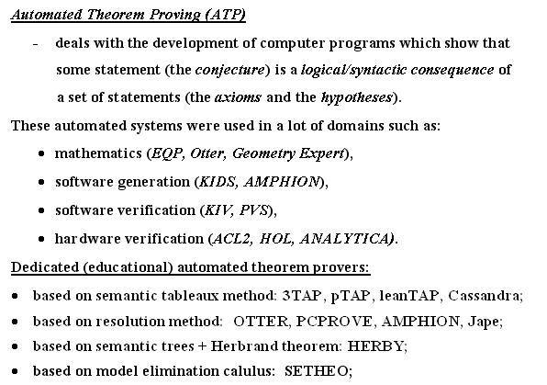

Slide 3
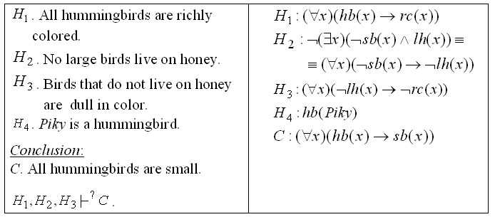
Example1

Slide 4
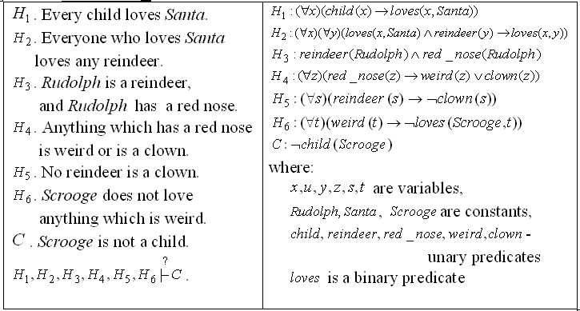
Example2

Slide 5
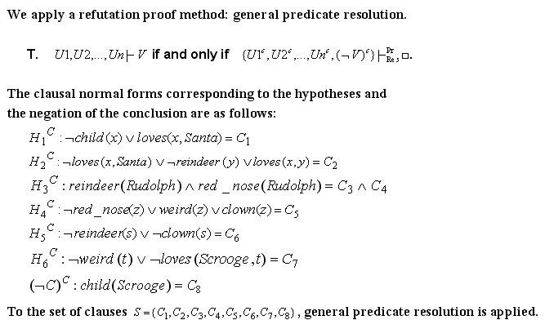
Example2 (contd.)

Slide 6
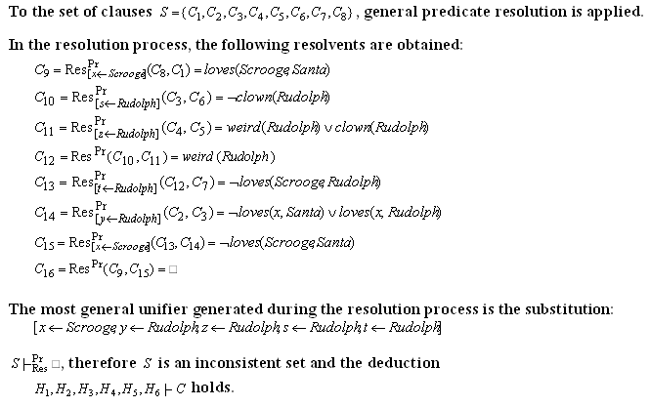
Example2 (contd.)

Slide 7
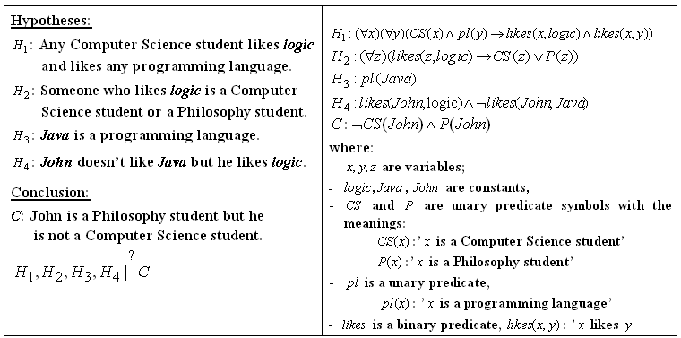
Example3

Slide 8
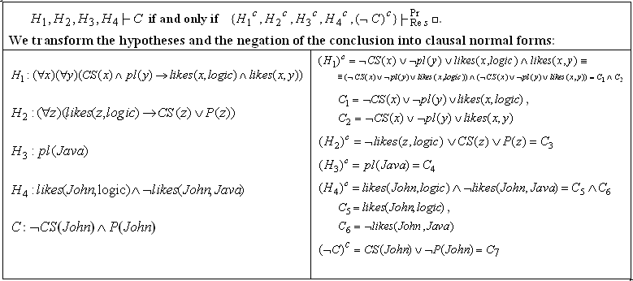
Example3 – Normal forms

Slide 9
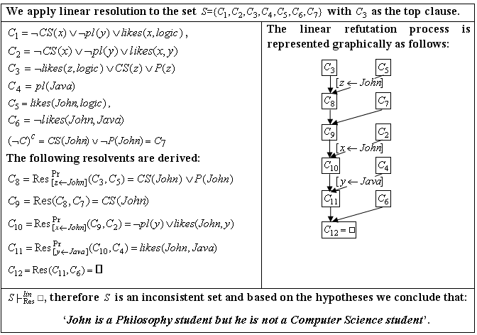
Example3 – Resolution process

Slide 10
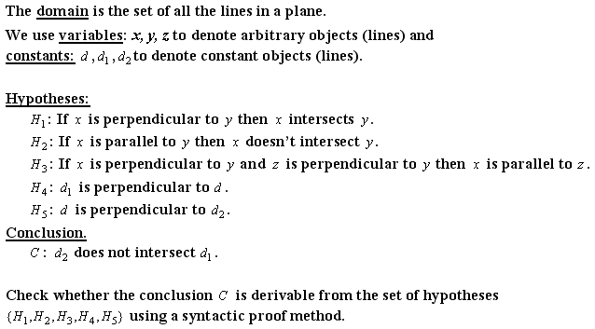
Example 4
Modeling reasoning in geometry using predicate logic

Slide 11
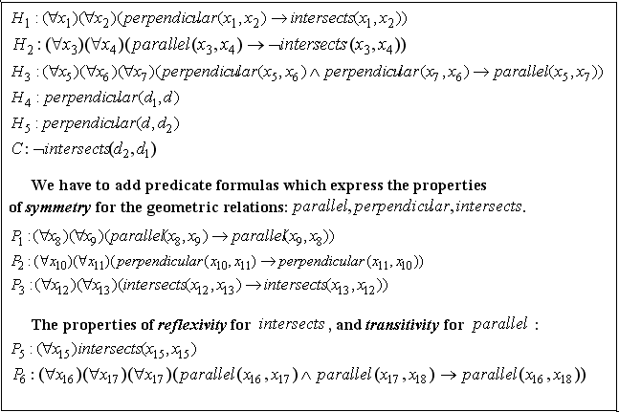
Example 4 – Predicate formulas

Slide 12
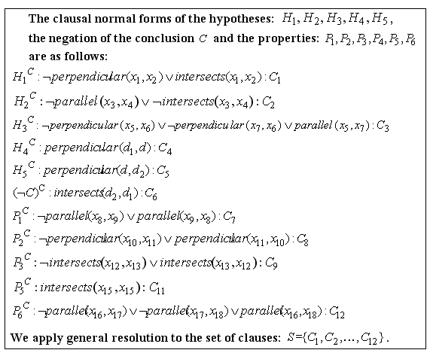
Example 4 – Normal forms

Slide 13
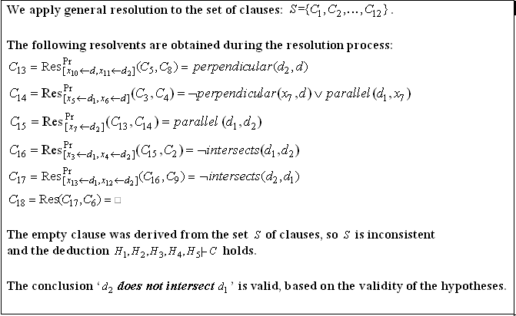
Example 4 – Resolution process

Slide 14
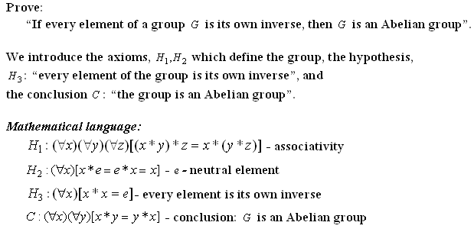
Example 5 - Mathematical reasoning modeling in algebra

Slide 15
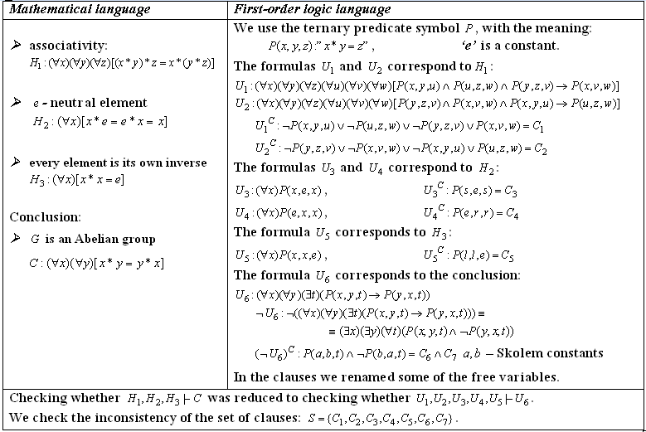
Example 5 – Predicate formulas and clauses

Slide 16
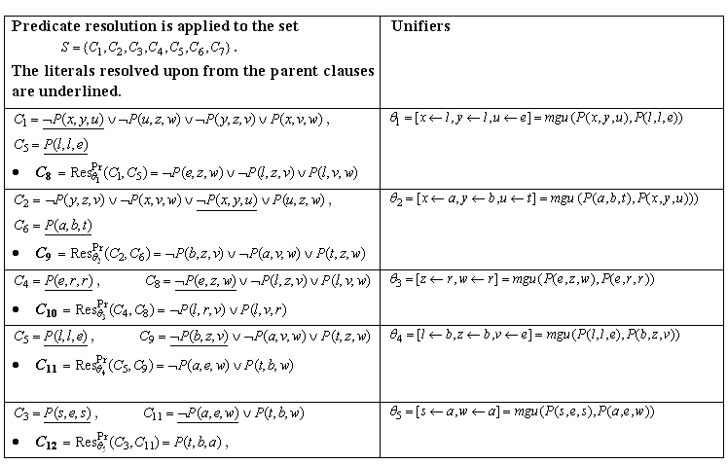
Example 5 – Resolution process

Slide 17
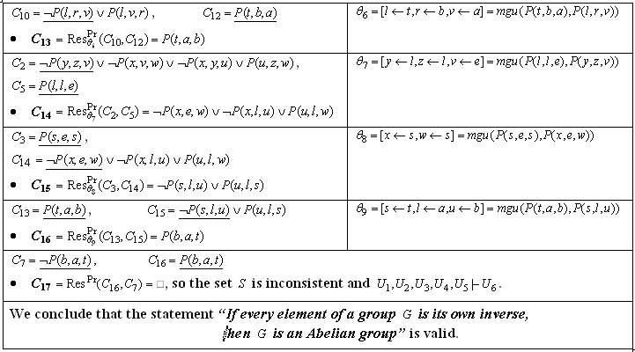
Example 5 – Resolution process (contd.)

Slide 18
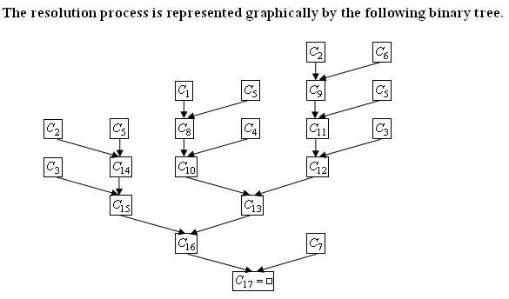
Example 5 (contd.)

